Slide 1
Divide And Conquer
Merge Sort, Quick Sort

Slide 2
Sorting
Arrange an unordered list of elements in some order.
Some common algorithms
Bubble Sort
Insertion Sort
Merge Sort
Quick Sort

Slide 3
Sorting
Important primitive
For today, we’ll pretend all elements are distinct.
6
4
3
8
1
5
2
7
1
2
3
4
5
6
7
8
Length of the list is n

Slide 4
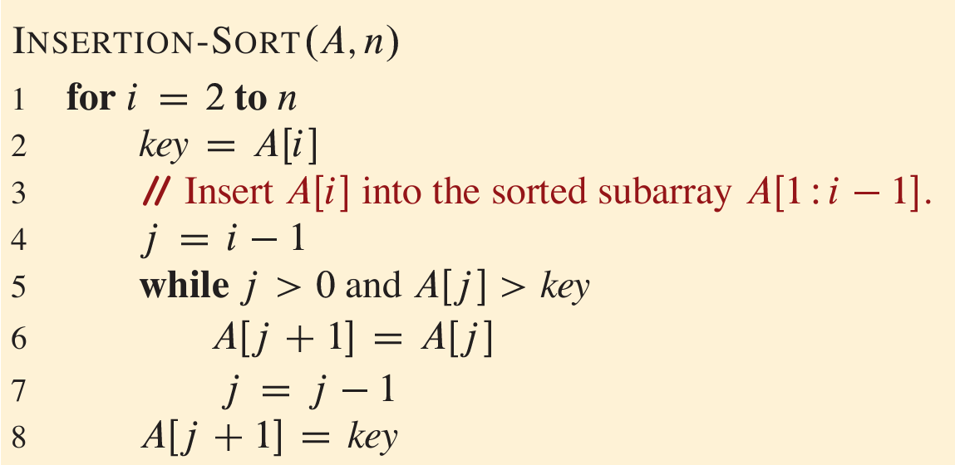
Insertion Sort (Recap)

Slide 5
Insertion Sort example
6
4
3
8
5
Start by moving A[1] toward the beginning of the list until you find something smaller (or can’t go any further):
Insertion-Sort(A, n)
for i = 1 to n – 1
key = A[i]
j = i – 1
while j >= 0 and A[j] > key
A[j + 1] = A[j]
j = j – 1
A[j + 1] = key
6
4
3
8
5
4
6
3
8
5

Slide 6
Insertion Sort example
6
4
3
8
5
Insertion-Sort(A, n)
for i = 1 to n – 1
key = A[i]
j = i – 1
while j >= 0 and A[j] > key
A[j + 1] = A[j]
j = j – 1
A[j + 1] = key
Then move A[2]:
key = 3
4
6
3
8
5
4
6
6
8
5
4
4
6
8
5
3
4
6
8
5

Slide 7
Insertion Sort example
6
4
3
8
5
Insertion-Sort(A, n)
for i = 1 to n – 1
key = A[i]
j = i – 1
while j >= 0 and A[j] > key
A[j + 1] = A[j]
j = j – 1
A[j + 1] = key
Then move A[3]:
key = 8
3
4
6
8
5
3
4
6
8
5

Slide 8
Insertion Sort example
6
4
3
8
5
Insertion-Sort(A, n)
for i = 1 to n – 1
key = A[i]
j = i – 1
while j >= 0 and A[j] > key
A[j + 1] = A[j]
j = j – 1
A[j + 1] = key
Then move A[4]:
key = 5
3
4
6
8
5
3
4
6
8
8
3
4
6
6
8
3
4
5
6
8

Slide 9
Insertion Sort example
6
4
3
8
5
Start by moving A[1] toward the beginning of the list until you find something smaller (or can’t go any further):
Then move A[3]:
6
4
3
8
5
3
4
6
8
5
4
6
3
8
5
3
4
6
8
5
Then move A[2]:
Then move A[4]:
4
6
3
8
5
3
4
6
8
5
3
4
6
8
5
3
4
5
6
8
Then we are done!

Slide 10
Why does this work?
Say you have a sorted list, , and another element .
Insert right after the largest thing that’s still smaller than . (Aka, right after ).
Then you get a sorted list:
3
4
6
8
5
5
5
4
3
4
5
6
8

Slide 11
This sounds like a job for…
Proof By Induction!

Slide 12
Outline of a proof by induction
Let A be a list of length n
Base case:
A[:1] is sorted at the end of the 0’th iteration. ✓
Inductive Hypothesis:
A[:i+1] is sorted at the end of the i^{th} iteration (of the outer loop).
Inductive step:
For any 0 < k < n, if the inductive hypothesis holds for i=k-1, then it holds for i=k.
Aka, if A[:k] is sorted at step k-1, then A[:k+1] is sorted at step k (previous slide)
Conclusion:
The inductive hypothesis holds for i = 0, 1, …, n-1.
In particular, it holds for i=n-1.
At the end of the n-1’st iteration (aka, at the end of the algorithm), A[:n] = A is sorted.
That’s what we wanted! ✓

Slide 13
Worst-case Analysis
In this class we will use worst-case analysis:
We assume that a “bad guy” produces a worst-case input for our algorithm, and we measure performance on that worst-case input.
How many operations are performed by the insertion sort algorithm on the worst-case input?

Slide 14
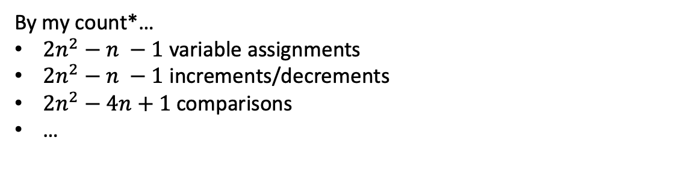
How fast is InsertionSort?
Let’s count the number of operations!
def InsertionSort(A):
for i in range(1,len(A)):
current = A[i]
j = i-1
while j >= 0 and A[j] > current:
A[j+1] = A[j]
j -= 1
A[j+1] = current
By my count*…
$2n^{2}−n −1$ variable assignments
$2n^{2}−n −1$ increments/decrements
$2n^{2}−4n+1$ comparisons
…
*A complete count of the operation will be insignificant from later discussion.

Slide 15
In this class we will use…
Big-Oh notation!
Gives us a meaningful way to talk about the running time of an algorithm, independent of programming language, computing platform, etc., without having to count all the operations.

Slide 16
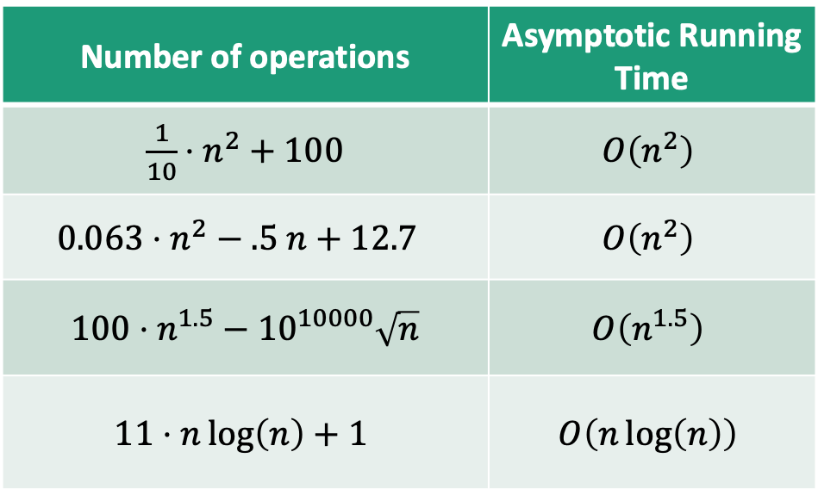
Main idea:
Focus on how the runtime scales with n (the input size).
Some examples…
(Heuristically: only pay attention to the largest function of n that appears.)
Number of operations | Asymptotic Running Time
$\frac{1}{10}⋅n^{2}+100$ | $$O\left(n^{2}\right)$$
$$0.063⋅n^{2}−.5 n+12.7$$ | $$O\left(n^{2}\right)$$
$100⋅n^{1.5}−{10}^{10000}\sqrt{n}$ | $$O\left(n^{1.5}\right)$$
$$11⋅n\log\left(n\right)+1$$ | $$O\left(n\log\left(n\right)\right)$$
We say this algorithm is “asymptotically faster” than the others.

Slide 17
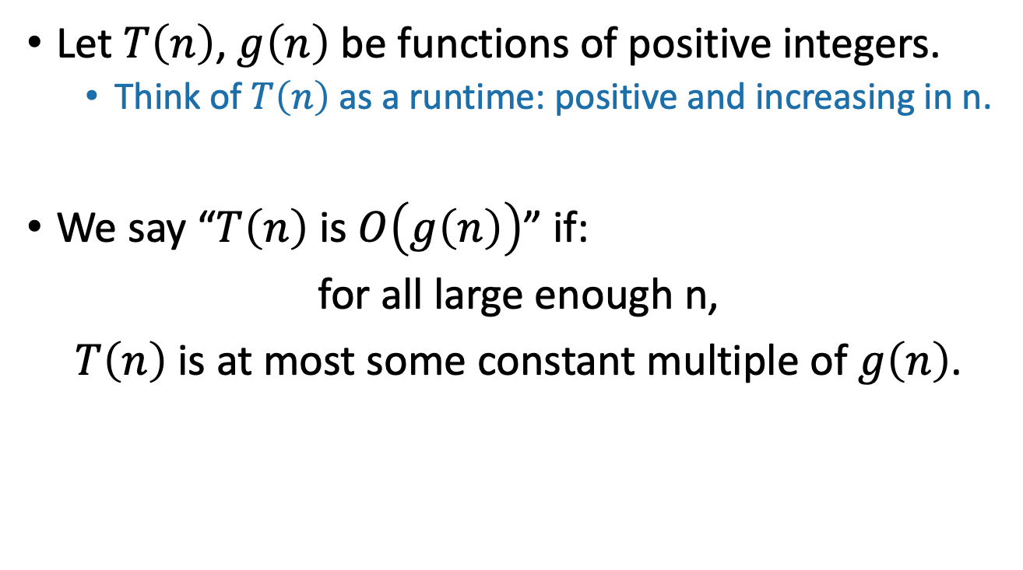
Informal definition for O(…)
Let $T\left(n\right)$, $g\left(n\right)$ be functions of positive integers.
Think of $T\left(n\right)$ as a runtime: positive and increasing in n.
We say “$T\left(n\right)$ is $O\left(g\left(n\right)\right)$” if:
for all large enough n,
$T\left(n\right)$ is at most some constant multiple of $g\left(n\right)$.
Here, “constant” means “some number that doesn’t depend on n.”

Slide 18
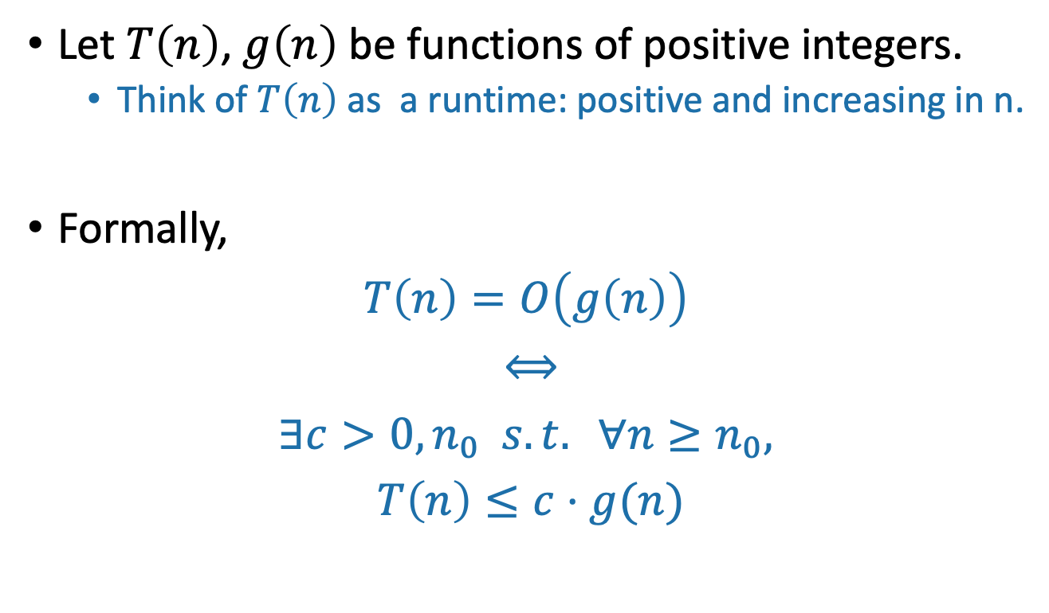
Formal definition of O(…)
Let $T\left(n\right)$, $g\left(n\right)$ be functions of positive integers.
Think of $T\left(n\right)$ as a runtime: positive and increasing in n.
Formally,
$$T\left(n\right)=O\left(g\left(n\right)\right)$$
$$⟺$$
$$∃c>0, n_{0} s.t. ∀n≥n_{0},$$
$$T\left(n\right)≤c⋅g(n)$$
“If and only if”
“For all”
“There exists”

Slide 19
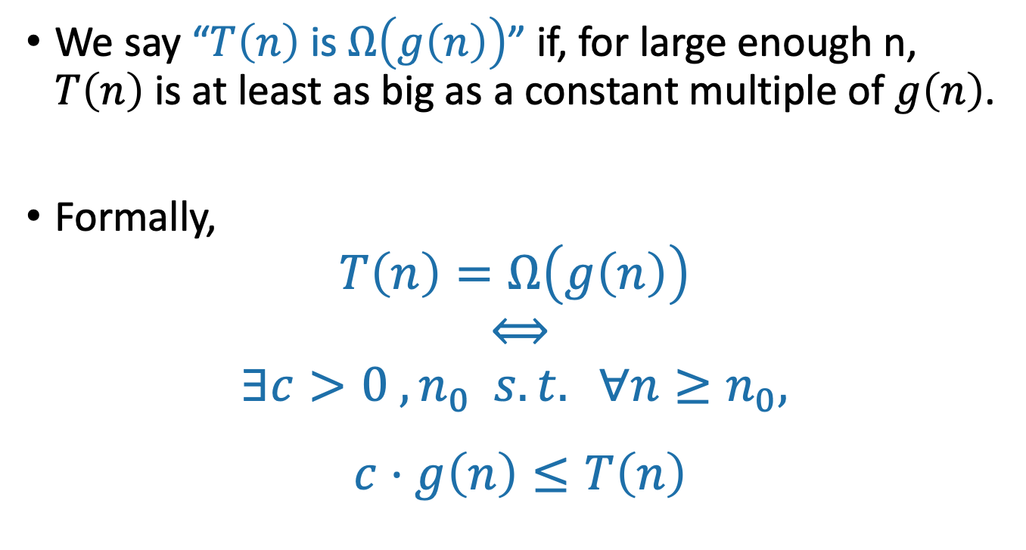
Ω(…) means a lower bound
We say “$T\left(n\right)$ is $Ω\left(g\left(n\right)\right)$” if, for large enough n, $T\left(n\right)$ is at least as big as a constant multiple of $g\left(n\right)$.
Formally,
$$T\left(n\right)=Ω\left(g\left(n\right)\right)$$
$$⟺$$
$$∃c>0 ,n_{0} s.t. ∀n≥n_{0},$$
$$c⋅g\left(n\right)≤T\left(n\right)$$
Switched these!!

Slide 20
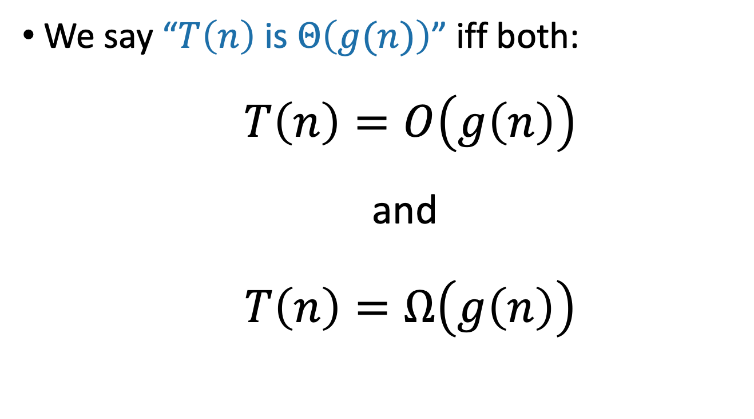
Θ(…) means both!
We say “$T\left(n\right)$ is $Θ\left(g(n)\right)$” iff both:
$T\left(n\right)=O\left(g\left(n\right)\right)$
and
$T\left(n\right)=Ω\left(g\left(n\right)\right)$

Slide 21
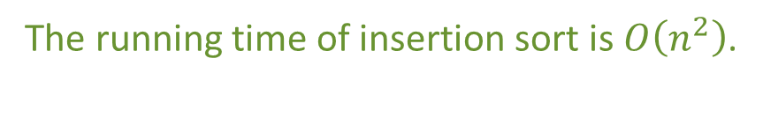
Insertion Sort: running time
def InsertionSort(A):
for i in range(1,len(A)):
current = A[i]
j = i-1
while j >= 0 and A[j] > current:
A[j+1] = A[j]
j -= 1
A[j+1] = current
n-1 iterations of the outer loop
In the worst case, about n iterations of this inner loop
The running time of insertion sort is $O\left(n^{2}\right)$.

Slide 22
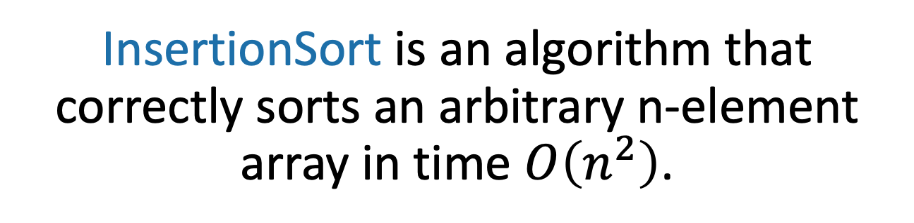
InsertionSort is an algorithm that correctly sorts an arbitrary n-element array in time $O\left(n^{2}\right)$.
Can we do better?

Slide 23
Can we do better?
MergeSort: a divide-and-conquer approach
Big problem
Smaller problem
Smaller problem
Recurse!
Recurse!
Yet smaller problem
Yet smaller problem
Yet smaller problem
Yet smaller problem

Slide 24
Divide-And-Conquer
Divide
Divide the problem into one or more smaller instances of the same problem.
Conquer
Solve them smaller problems recursively.
Combine
Merge/ combine the solutions to solve the original problem.

Slide 25
Why insertion sort works? (Recap)
Say you have a sorted list, , and another element .
Insert right after the largest thing that’s still smaller than . (Aka, right after ).
Then you get a sorted list:
What if you have two
sorted lists?
3
4
6
8
5
5
5
4
3
4
5
6
8
3
4
6
8
2
5
9
11

Slide 26
MergeSort
6
4
3
8
1
5
2
7
6
4
3
8
1
5
2
7
Recursive magic!
Recursive magic!
3
4
6
8
1
2
5
7
MERGE!
1
2
3
4
5
6
7
8

Slide 27
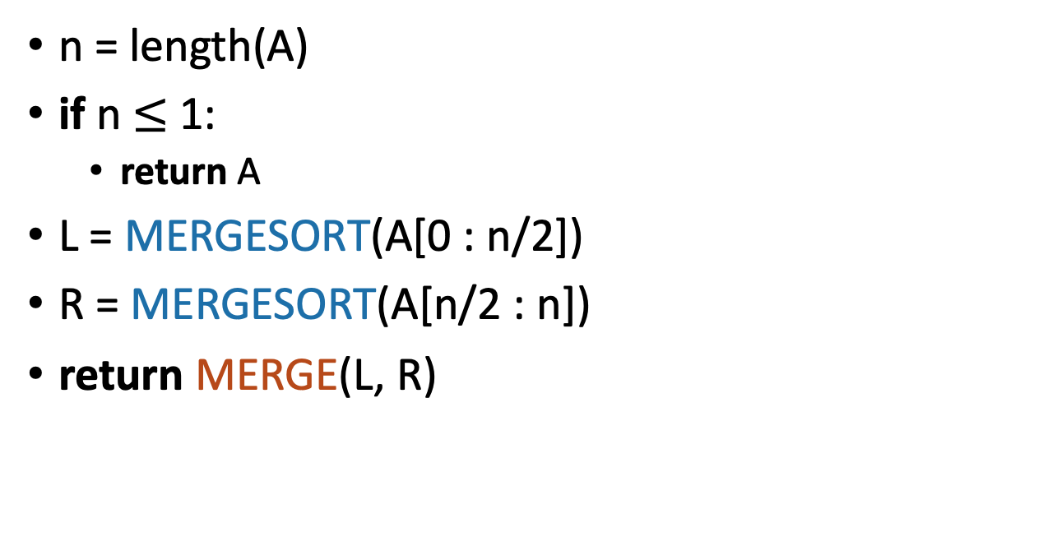
MergeSort Pseudocode
MERGESORT(A):
n = length(A)
if n $≤$ 1:
return A
L = MERGESORT(A[0 : n/2])
R = MERGESORT(A[n/2 : n])
return MERGE(L, R)
If A has length 1,
It is already sorted!
Sort the left half
Sort the right half
Merge the two halves
Notes:
Okay, this pseudo-code is actually pretty intuitive, it's follows our english description.
(Question to ponder: what if we wanted to do this in-place?)

Slide 28
What actually happens? First, recursively break up the array all the way down to the base cases
6
4
3
8
1
5
2
7
6
4
3
8
1
5
2
7
6
4
3
8
1
5
2
7
6
4
3
8
1
5
2
7
This array of length 1 is sorted!

Slide 29
Then, merge them all back up!
Sorted sequence!
1
2
3
4
5
6
7
8
Merge!
3
4
6
8
1
2
5
7
Merge!
Merge!
4
6
3
8
1
5
2
7
Merge!
Merge!
Merge!
Merge!
6
4
3
8
1
5
2
7
A bunch of sorted lists of length 1 (in the order of the original sequence).
Notes:
Here's a different way of looking at merge sort. Let's take the same example, and think about it in terms of what order the MERGE calls happen in (instead of what order the recursive calls happen in)

Slide 30
Does it work?
Yet another job for proof by induction!!!
Try it yourself.

Slide 31
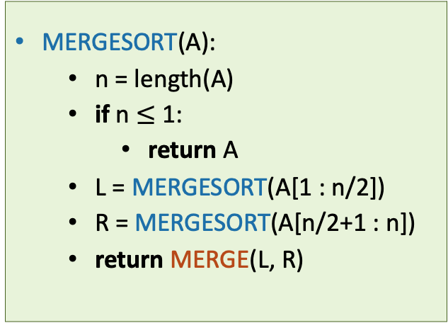
It works
THIS SLIDE SKIPPED IN CLASS
Assume that n is a power of 2 for convenience.
Inductive hypothesis:
“In every recursive call on an array of length at most i, MERGESORT returns a sorted array.”
Base case (i=1): a 1-element array is always sorted.
Inductive step: Need to show: if the inductive hypothesis holds for k<i, then it holds for k=i.
Aka, need to show that if L and R are sorted, then MERGE(L,R) is sorted.
Conclusion: In the top recursive call, MERGESORT returns a sorted array.
MERGESORT(A):
n = length(A)
if n $≤$ 1:
return A
L = MERGESORT(A[1 : n/2])
R = MERGESORT(A[n/2+1 : n])
return MERGE(L, R)
Fill in the inductive step!
HINT: You will need to prove that the MERGE algorithm is correct, for which you may need…another proof by induction!

Slide 32
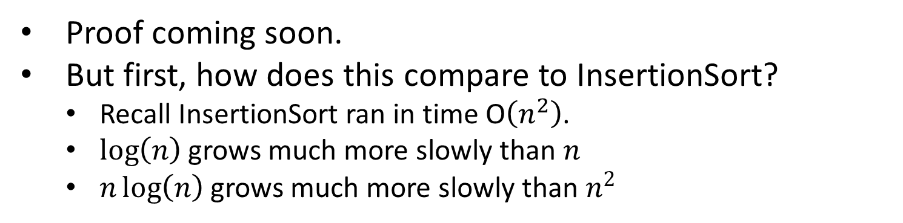
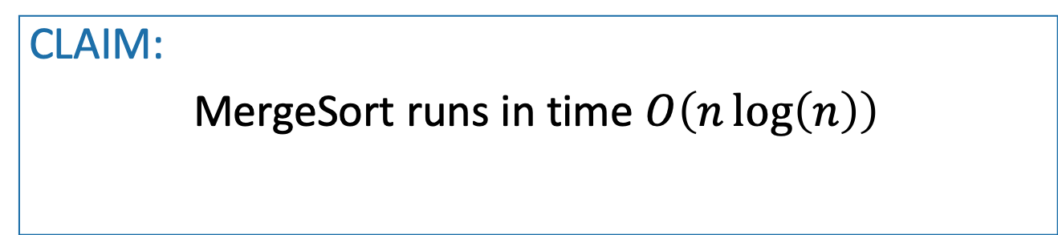
It’s fast
Assume that n is a power of 2 for convenience.
CLAIM:
MergeSort runs in time $O\left(n\log\left(n\right)\right)$
Proof coming soon.
But first, how does this compare to InsertionSort?
Recall InsertionSort ran in time O$\left(n^{2}\right)$.
$\log\left(n\right)$ grows much more slowly than $n$
$n\log\left(n\right)$ grows much more slowly than $n^{2}$

Slide 33

Now let’s prove the claim
Assume that n is a power of 2 for convenience.
CLAIM:
MergeSort runs in time $O\left(n\log\left(n\right)\right)$

Slide 34
Let’s prove the claim
Size n
Level 0
n/2
n/2
Level 1
n/4
n/4
n/4
n/4
Focus on just one of these sub-problems
…
Level t
2^{t} subproblems at level t.
n/2^{t}
n/2^{t}
n/2^{t}
n/2^{t}
n/2^{t}
n/2^{t}
…
(Size 1)
Level log(n)

Slide 35
How much work in this sub-problem?
n/2^{t}
Time spent MERGE-ing the two subproblems
+
n/2^{t+1}
n/2^{t+1}
Time spent within the two sub-problems

Slide 36
How much work in this sub-problem?
Let k=n/2^{t}…
k
Time spent MERGE-ing the two subproblems
+
k/2
k/2
Time spent within the two sub-problems

Slide 37
How long does it take to MERGE?
k
k/2
k/2
Answer: It takes time O(k), since we just walk across the list once.
k/2
k/2
3
4
6
8
1
2
5
7
MERGE!
1
2
3
4
5
6
7
8
k

Slide 38
Recursion tree
Size n
n/2
n/2
n/4
n/4
n/4
n/4
…
n/2^{t}
n/2^{t}
n/2^{t}
n/2^{t}
n/2^{t}
n/2^{t}
There are O(k) operations done at this node.
…
k
(Size 1)
k/2
k/2

Slide 39
Recursion tree
Size n
How many operations are done at this level of the tree? (Just MERGE-ing subproblems).
n/2
n/2
How about at this level of the tree?
(between both n/2-sized problems)
n/4
n/4
n/4
n/4
This level?
…
This level?
n/2^{t}
n/2^{t}
n/2^{t}
n/2^{t}
n/2^{t}
n/2^{t}
There are O(k) operations done at this node.
…
k
(Size 1)
k/2
k/2

Slide 40
Recursion tree
Work this out yourself!
Size of each
problem
#
problems
Amount of work at this level
Level
Size n
0
1
2
4
2^{t}
n
n
n/2
n/4
n/2^{t}
1
O(n)
O(n)
O(n)
O(n)
O(n)
n/2
n/2
1
n/4
n/4
n/4
n/4
2
…
…
n/2^{t}
n/2^{t}
n/2^{t}
n/2^{t}
n/2^{t}
n/2^{t}
t
…
…
log(n)
(Size 1)

Slide 41
Total runtime…
O(n) steps per level, at every level
log(n) + 1 levels
O( n log(n) ) total!
That was the claim!

Slide 42
What have we learned?
MergeSort correctly sorts a list of n integers in time O(n log(n) ).
That’s (asymptotically) better than InsertionSort!

Slide 43
Can we do better?
Any deterministic compare-based sorting algorithm must make Ω(n log n) compares in the worst-case.
How to prove this?
Is there any other way to sort an array efficiently?

Slide 44
QuickSort
QuickSort: another divide-and-conquer approach
Divide
Partition the array A[1:n] into two (possibly empty) subarrays A[1:q-1] (the low side) and A [q+1:n] (the high side)
Each element in the low side of the partition is <=A[q] Each element in the high side is of the partition >= A[q].
Compute the index q of the pivot as part of this partitioning procedure.
Conquer
Recursively sort the subarrays A[1:q-1] and A[q+1:n]
Combine
Already sorted

Slide 45
Pseudocode of QuickSort
QUICKSORT(A, p, r)
if p < r
q = PARTITION(A, p, r) QUICKSORT(A, p, q – 1) QUICKSORT(A, q+1, r)

Slide 46
PARTITION
PARTITION(A, p, r)
x = A[r]
i = p – 1
for j = p to r – 1
if A[j] <= x
i = i + 1
exchange A[i] with A[j]
exchange A[i + 1] with A[r]
return i + 1

Slide 47
Example of PARTITION
i = -1
7
6
3
5
1
2
4
Pick 4 as a pivot
j = 0
j = 1
j = 2

Slide 48
Example of PARTITION
i = -1
i = 0
3
6
7
5
1
2
4
Pick 4 as a pivot
j = 3
j = 4

Slide 49
Example of PARTITION
i = 0
i = 1
3
1
7
5
6
2
4
Pick 4 as a pivot
j = 5

Slide 50
Example of PARTITION
i = 1
i = 2
3
1
2
5
6
7
4
Pick 4 as a pivot

Slide 51
Example of PARTITION
Low Side
High Side
3
1
2
4
6
7
5
Set the pivot in place

Slide 52
Example of recursive calls
7
6
3
5
1
2
4
Pick 4 as a pivot
3
1
2
4
6
7
5
Partition on either side of 4
Recurse on [312] and pick 2 as a pivot.
1
2
3
4
5
6
7
Recurse on [67] and pick 7 as a pivot.
1
2
3
4
5
6
7

Slide 53


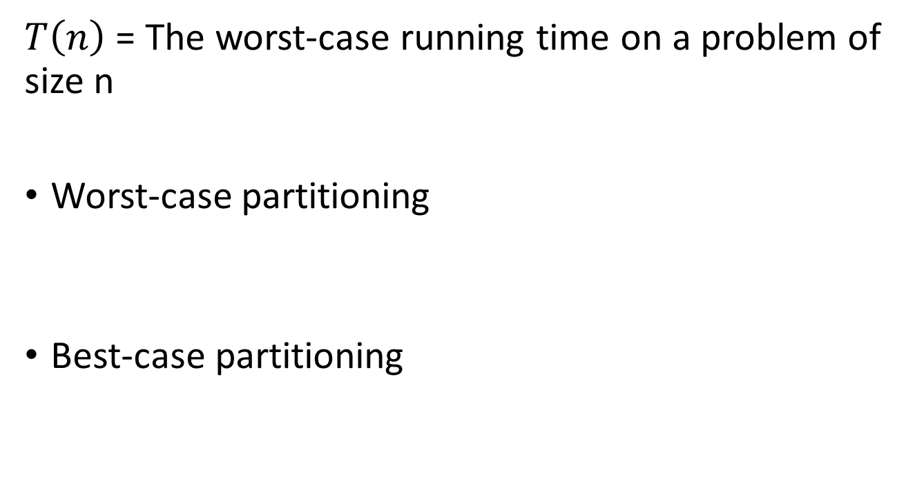
QuickSort Runtime Analysis
$T\left(n\right)$ = The worst-case running time on a problem of size n
Worst-case partitioning
Best-case partitioning

Slide 54
Recurrences
An equation that describes a function in terms of its value on other, typically smaller, arguments.
Recursive Case
Involves the recursive invocation of the function on different (usually smaller) inputs
Base Case
Does not involve a recursive invocation

Slide 55
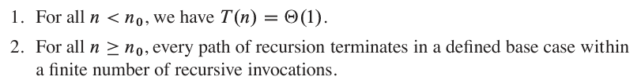

Algorithmic Recurrences
A recurrence $T\left(n\right)$ is algorithmic if, for every sufficiently large threshold constant $n_{0}<n$, the following two properties hold,

Slide 56
Solving Recurrences
Substitution Method
Guess a solution
Use mathematical induction to prove the guess

Slide 57
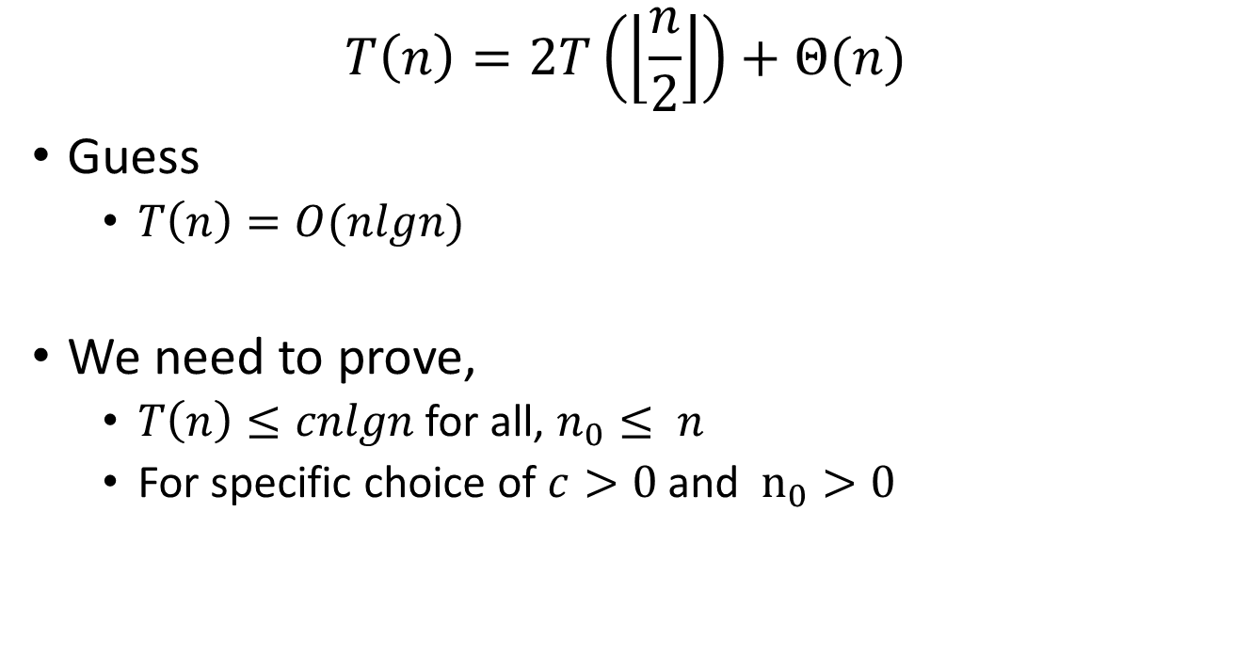
Substitution Method
$$T\left(n\right)=2T\left(\left\lfloor \frac{n}{2}\right\rfloor \right)+Θ(n)$$
Guess
$T\left(n\right)=O(nlgn)$
We need to prove,
$T\left(n\right)≤cnlgn$ for all, $n_{0}≤ n$
For specific choice of $c>0$ and $n_{0}>0$

Slide 58

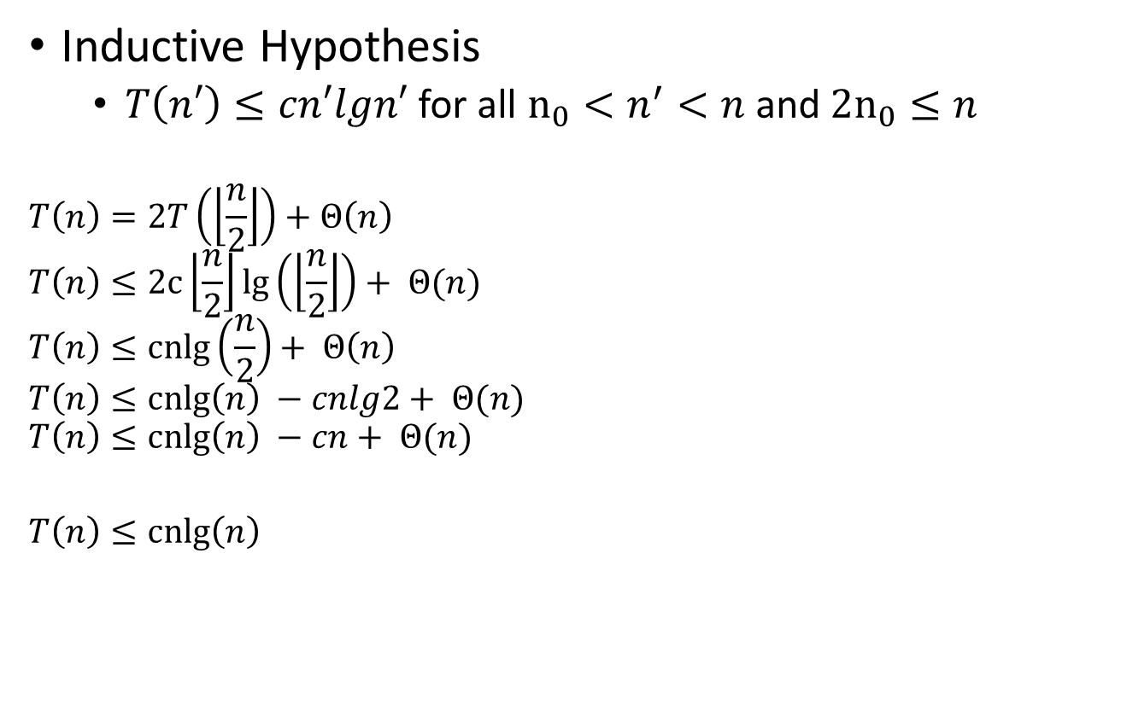
Substitution Method
Inductive Hypothesis
$T\left(n′\right)≤cn′lgn′$ for all $n_{0}<n^{′}<n$ and ${2n}_{0}≤n$
$$T\left(n\right)=2T\left(\left\lfloor \frac{n}{2}\right\rfloor \right)+Θ\left(n\right)$$
$$T\left(n\right)≤2c\left\lfloor \frac{n}{2}\right\rfloor lg\left(\left\lfloor \frac{n}{2}\right\rfloor \right)+ Θ(n)$$
$$T\left(n\right)≤cnlg\left(\frac{n}{2}\right)+ Θ\left(n\right)$$
$$T\left(n\right)≤cnlg\left(n\right) −cnlg2+ Θ(n)$$
$$T\left(n\right)≤cnlg\left(n\right) −cn+ Θ(n)$$
$$T\left(n\right)≤cnlg\left(n\right)$$
If $n_{0}is sufficiently large and$ cn dominates $Θ(n)$

Slide 59

Substitution Method
Base Case
$n_{0}≤n<2n_{0}$
Assuming
$n_{0}=2$
$c=max⁡(T\left(2\right), T(3))$
We get $T\left(n\right)≤cnlgn$

Slide 60
Solving Recurrences
Substitution Method
Guess a solution
Use mathematical induction to prove the guess
Making a good guess may be difficult
Need to be careful about common pitfalls.

Slide 61
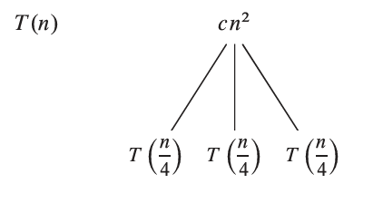

Recursion Tree
Consider the recurrence
$$T\left(n\right)=3 T\left(\frac{n}{4}\right)+Θ\left(n^{2}\right)$$

Slide 62
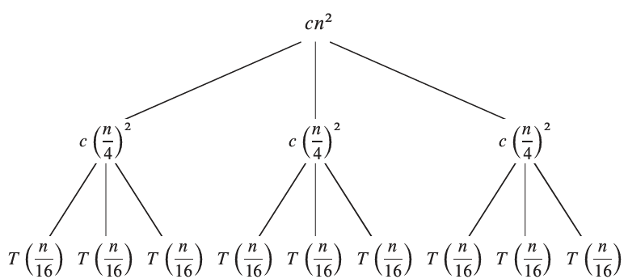
Recursion Tree
Consider the recurrence
$$T\left(n\right)=3 T\left(\frac{n}{4}\right)+Θ\left(n^{2}\right)$$

Slide 63
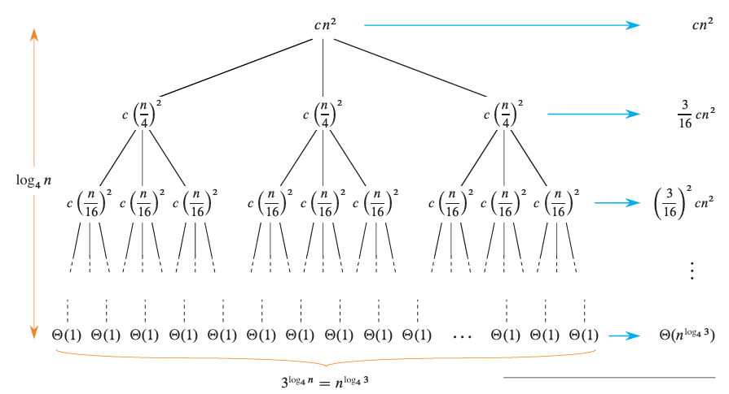
Recursion Tree

Slide 64
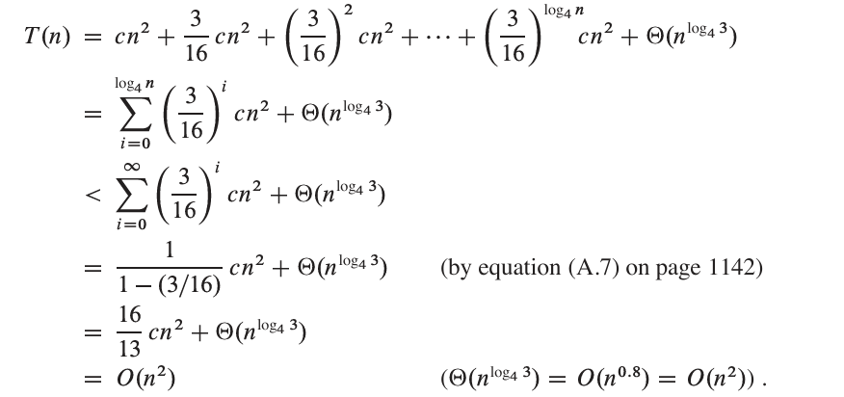
Recursion Tree

Slide 65
Recursion Tree
Unbalanced recursion tree
Estimate the height of the tree
Estimate the cost from each level
Estimate the number of leave nodes of the tree
Estimate the cost from all the leaf nodes over all the levels
Example

Slide 66

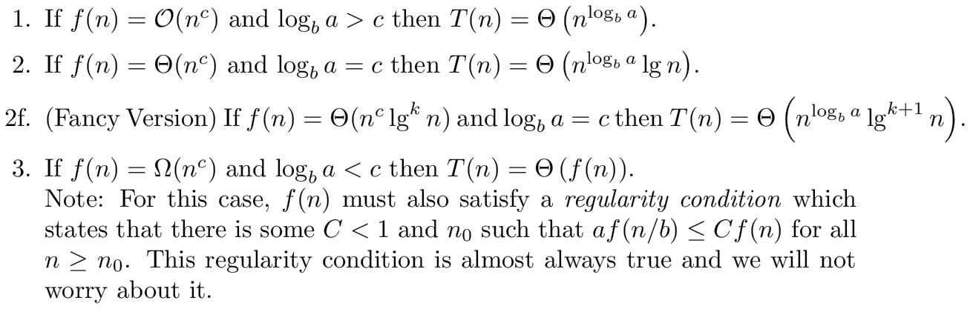
Master Theorem
Let’s consider the following recurrence relation,
a > 0
b > 1
Driving Function

Slide 67
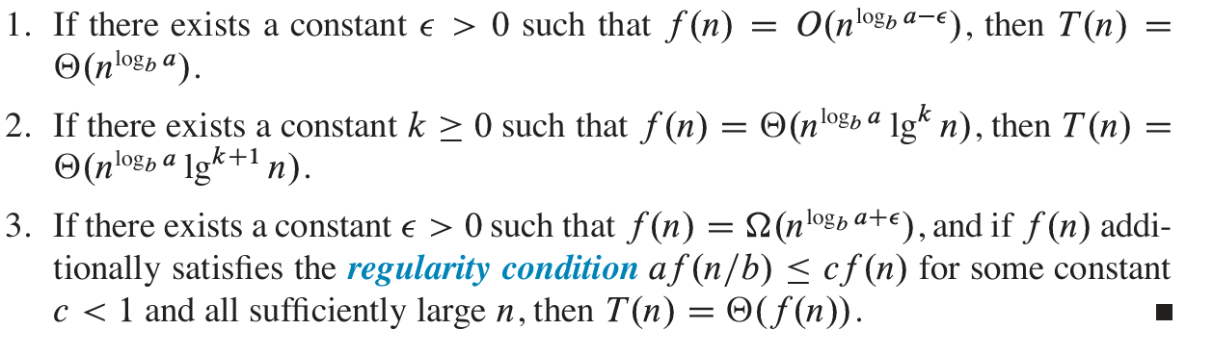
Master Theorem
Let’s consider the following recurrence relation,
a > 0
b > 1
Driving Function

Slide 68

Master Theorem
$$T\left(n\right)=9 T\left(\frac{n}{3}\right)+n$$
$a=9, b=3$
$f\left(n\right)=n= O\left(n^{1}\right)=O\left(n^{c}\right)$
$\log_{b}{a=log_{3}9=2>c{ }}$
$$T\left(n\right)=Θ(n^{2})$$

Slide 69
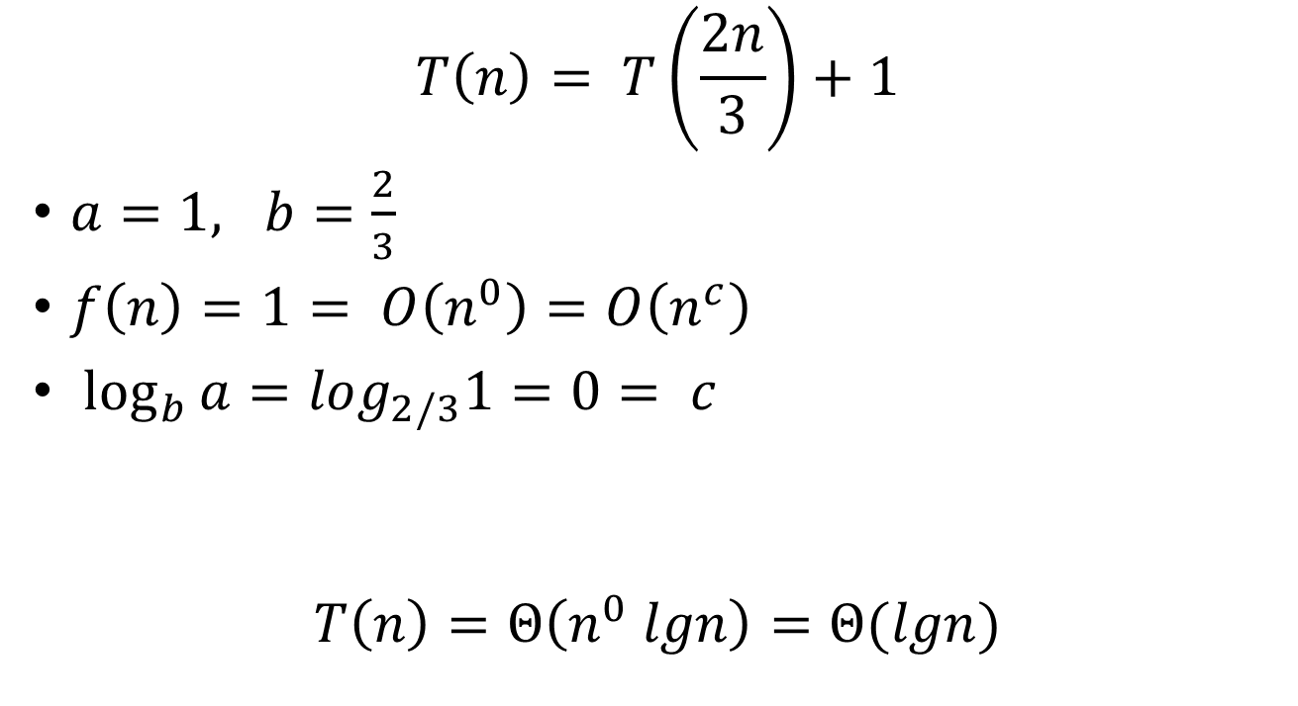
Master Theorem
$$T\left(n\right)= T\left(\frac{2n}{3}\right)+1$$
$a=1, b=\frac{2}{3}$
$f\left(n\right)=1= O\left(n^{0}\right)=O\left(n^{c}\right)$
$\log_{b}{a=log_{2/3}1=0= c{ }}$
$$T\left(n\right)=Θ\left(n^{0} lgn\right)=Θ(lgn)$$

Slide 70
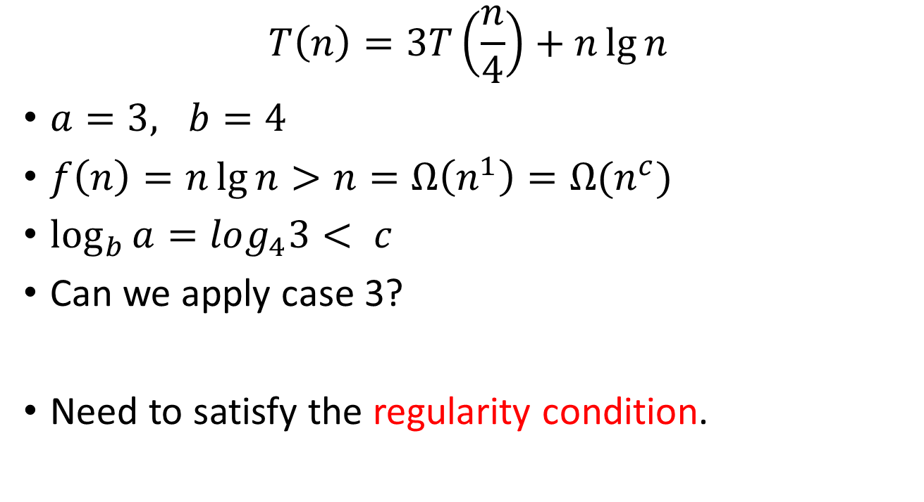
Master Theorem
$$T\left(n\right)=3T\left(\frac{n}{4}\right)+n\lg{n}$$
$a=3, b=4$
$f\left(n\right)=n\lg{n}>n=Ω\left(n^{1}\right)=Ω(n^{c})$
$\log_{b}{a=log_{4}3< c{ }}$
Can we apply case 3?
Need to satisfy the regularity condition.

Slide 71
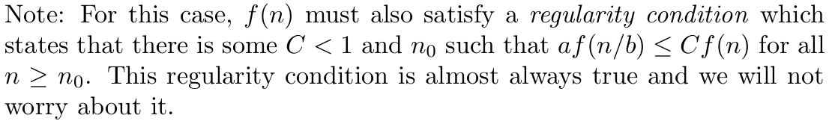
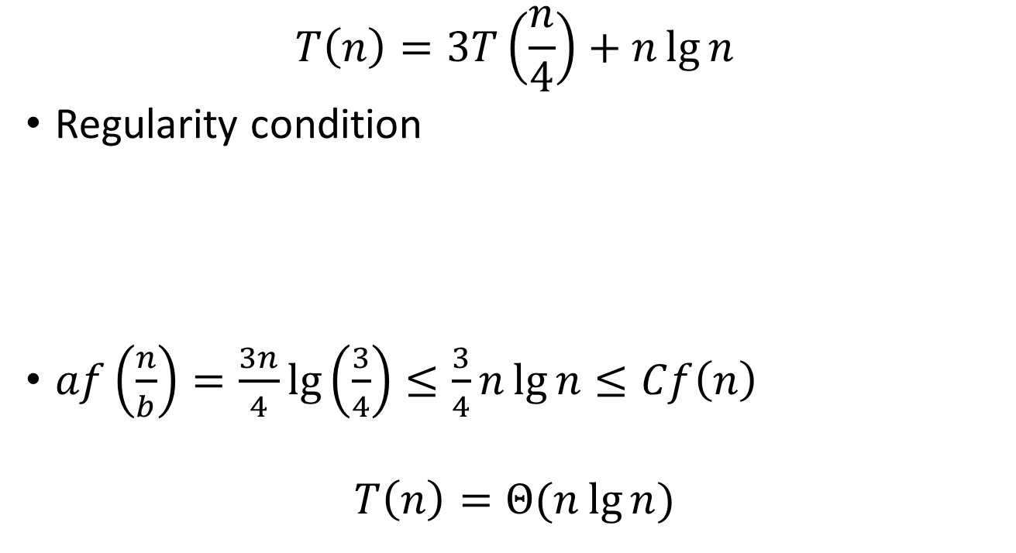
Master Theorem
$$T\left(n\right)=3T\left(\frac{n}{4}\right)+n\lg{n}$$
Regularity condition
$af\left(\frac{n}{b}\right)=\frac{3n}{4}\lg\left(\frac{3}{4}\right)≤\frac{3}{4}n\lg{n}≤Cf\left(n\right)$
$$T\left(n\right)=Θ(n\lg{n})$$

Slide 72

Master Theorem
$$T\left(n\right)=2T\left(\frac{n}{2}\right)+n\lg{n}$$
Applying master theorem (case 2),
$$T\left(n\right)=Θ(n\lg^{2}{n})$$

Slide 73

MergeSort Runtime Analysis (Revisit)
$$T\left(n\right)=2T\left(\frac{n}{2}\right)+Θ(n)$$
Applying master theorem (case 2),
$$T\left(n\right)=Θ(n\lg{n})$$

Slide 74
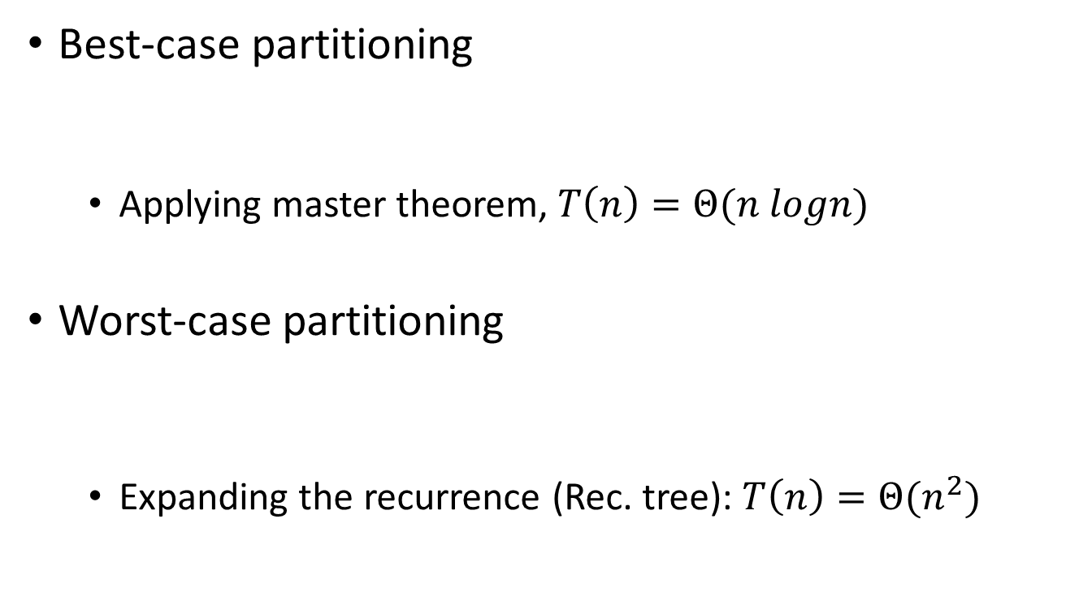
QuickSort Runtime Analysis (Revisit)
Best-case partitioning
Applying master theorem, $T\left(n\right)=Θ(n logn)$
Worst-case partitioning
Expanding the recurrence (Rec. tree): $T\left(n\right)=Θ(n^{2})$

Slide 75
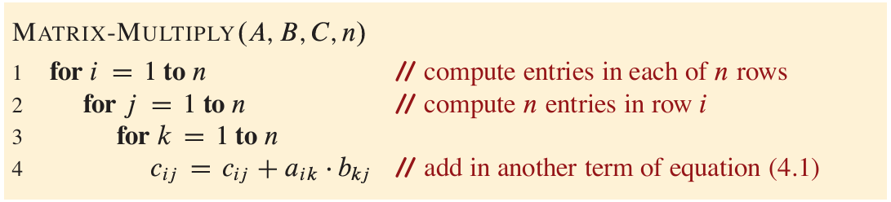

Multiplying Square Matrices
A and B are square matrices
Find out $C=A∗B$
Running Time $Θ(n^{3})$
Can we do better?

Slide 76
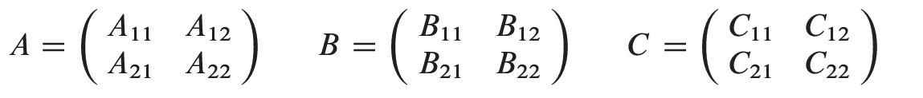
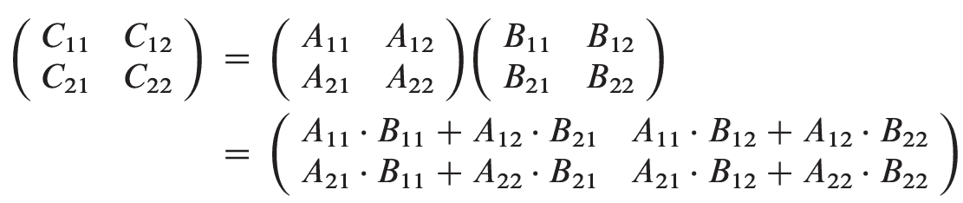
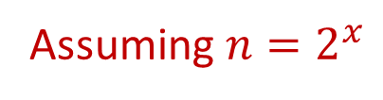
Multiplying Square Matrices
Assuming $n=2^{x}$
Divide
Conquer

Slide 77
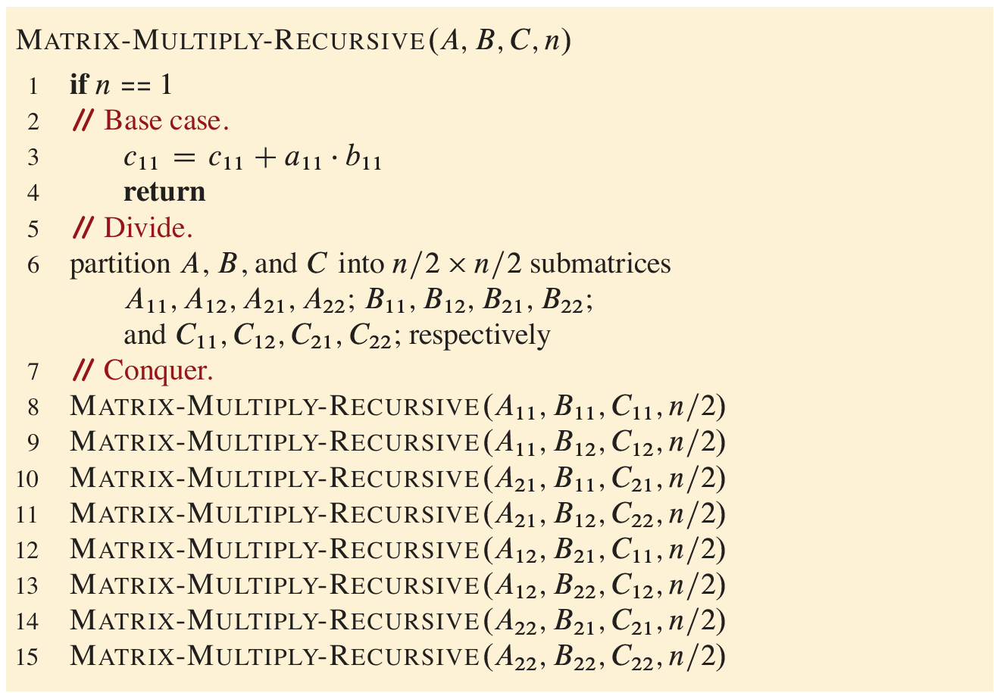


Multiplying Square Matrices
$$Θ(1)$$
$$8T(\frac{n}{2})$$

Slide 78

Multiplying Square Matrices
Running Time
$$T\left(n\right)=8 T\left(\frac{n}{2}\right)+Θ\left(1\right)$$
Applying master theorem (case 1),
$$T\left(n\right)=Θ\left(n^{3}\right)$$
Can we do better?

Slide 79

Strassen’s Algorithm
Intuitions,
Addition is faster than multiplications.
$Θ\left(n^{2}\right) vs Θ(n^{3})$
Replace multiplications with additions
Remember $x^{2} −y^{2}=(x+y )(x −y)$

Slide 80
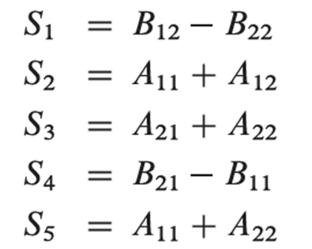
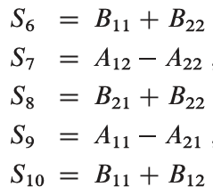
Strassen’s Algorithm
Divide (same as before)
Conquer
Perform 10 additions

Slide 81
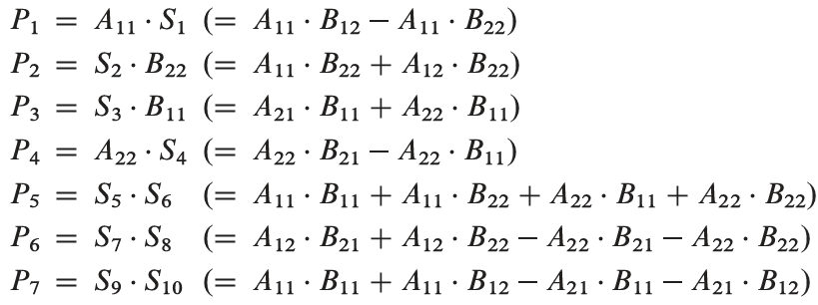

Strassen’s Algorithm
Divide (same as before)
Conquer
Perform 10 additions, $S_{1},S_{2},…, S_{10}$
Perform 7 multiplications

Slide 82


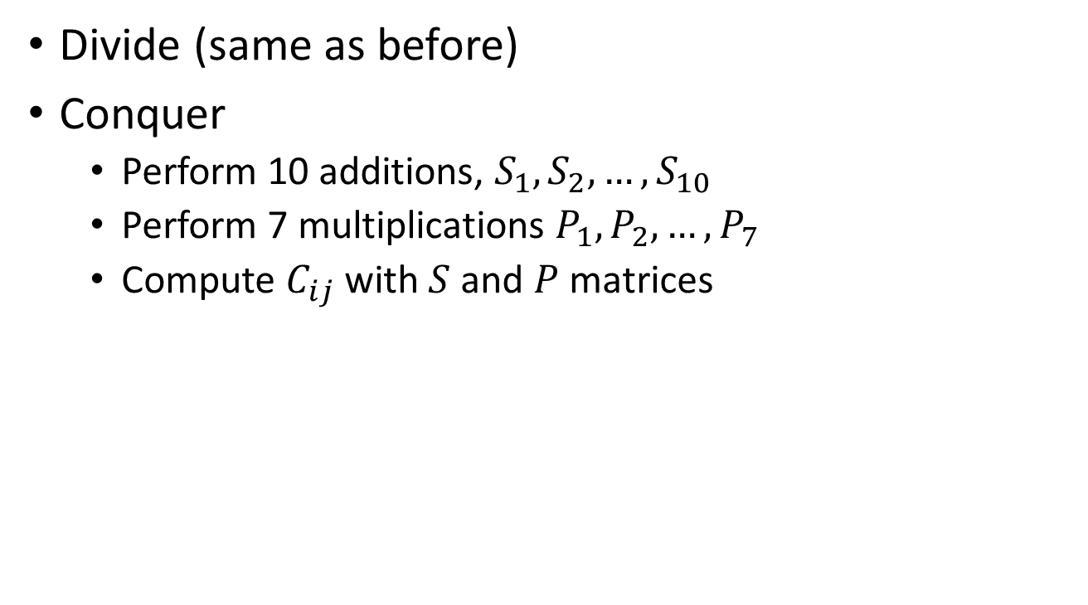
Strassen’s Algorithm
Divide (same as before)
Conquer
Perform 10 additions, $S_{1},S_{2},…, S_{10}$
Perform 7 multiplications $P_{1}, P_{2},…, P_{7}$
Compute $C_{ij}$ with $S$ and $P$ matrices

Slide 83
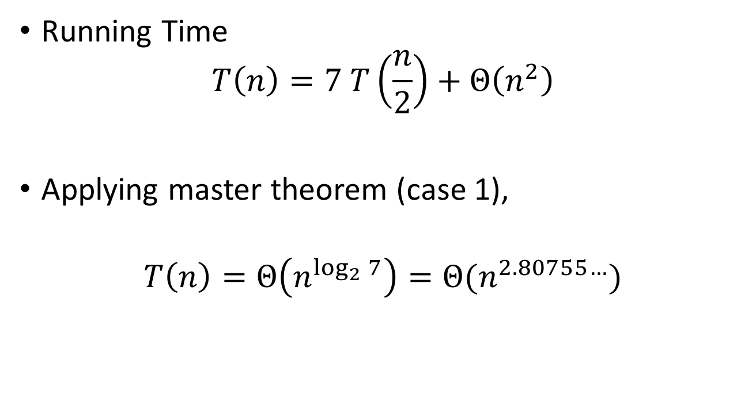
Strassen’s Algorithm Runtime Analysis
Running Time
$$T\left(n\right)=7 T\left(\frac{n}{2}\right)+Θ\left(n^{2}\right)$$
Applying master theorem (case 1),
$$T\left(n\right)=Θ\left(n^{\log_{2}{7}}\right)=Θ(n^{2.80755…})$$

Slide 84
Reference
Introduction to Algorithms, CLRS, 4th edition.
Chapter 2 (Getting Started)
Section 2.1, 2.3
Chapter 4 (Divide-and-Conquer)
Sections 4.1 – 4.5
Chapter 7 (Quick Sort)
Sections 7.1 and 7.2
Additional Resource:
mastertheorem.pdf

